Slide 1


AI-Powered Financial Analyst Chat Bot
A Secure, Conversational Application for Balance Sheet Analysis using Google Gemini
Jagruth N
August 7, 2025

Slide 2
Project Overview
The Assignment: Elevating Financial Analysis
The objective was to develop a sophisticated Chat-GPT style application, specifically tailored for balance sheet analysts to efficiently review public financial statements.
Automate Data Extraction
Generate Actionable Insights
Eliminate the slow, manual process of extracting key metrics from dense PDF reports.
Move beyond raw data to provide actionable intelligence for top management decision-making.
Ensure Strict Security
Enable Public Accessibility
Implement a multi-tenant system with granular, role-based access control (RBAC).
The final application needed to be live and publicly accessible, ensuring broad utility.

Slide 3
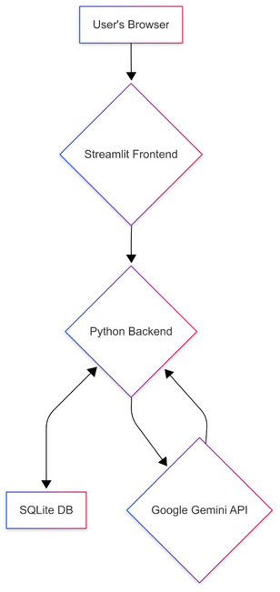
Foundations
The Solution: Robust Architecture & Tech Stack
This platform is built on a modern, scalable Python-based architecture, leveraging cutting-edge technologies for optimal performance.
Core Components
Architectural Flow
Frontend: Streamlit for rapid, interactive UI.
Backend & DB: Python, SQLite for logic & data storage.
AI Engine: Google Gemini Pro for advanced extraction and analysis.
PDF Parsing: PyMuPDF for efficient document processing.
Data Viz: Plotly for dynamic and insightful visualizations.

Slide 4




Core Functionality
Fort-Knox Security: Multi-Tenant Access
Data security and confidentiality are paramount. This application is designed with granular, role-based access control (RBAC).
Secure Login
Group Owner
Industry-standard password hashing protects all user accounts.
Mukesh Ambani: Consolidated view of all companies in their designated group.
CEO
Analyst
Reliance CEO: Siloed view, restricted to only their specific company's data.
Analyst User: Can only view companies explicitly assigned to them.

Slide 5

AI at the Core
The Gemini AI Engine: Intelligence Unleashed
Google Gemini Pro powers the platform, transforming raw financial data into actionable insights through sophisticated AI capabilities.
Automated Data Extraction
Conversational Analysis (Q&A)
Feeds raw text from financial reports to Gemini.
Users query in plain English.
App retrieves relevant data for Gemini context.
Specialized prompts identify key metrics (Revenue, Assets, Liabilities).
Ensures factually grounded, reliable insights.
Gemini returns structured JSON, eliminating manual entry.

Slide 6
Overcoming Obstacles
Development Journey: Problem-Solving in Action
This project demonstrates robust problem-solving, navigating real-world technical challenges to deliver a resilient application.
Initial Hurdles with OpenAI
Migration to Google Gemini
Encountered model access issues, prompting a strategic pivot.
Application successfully re-engineered to use the Gemini API, ensuring continuity.
Solving API Errors
Resolving Dependencies
Systematically diagnosed and resolved "404 Model Not Found" errors by programmatically verifying available models.
Addressed and fixed runtime ImportError issues by identifying and installing optional dependencies like tabulate.
Outcome: A thoroughly debugged and resilient final application, ready for deployment.

Slide 7
Interactive Session
Live Demo Walkthrough

Slide 8
Interactive Session
Live Demo Walkthrough
Join us for a live demonstration showcasing the application's capabilities and intuitive interface.
1
Role-Based Views
2
Interactive Dashboard
3
Chatbot Interaction
Login as CEO (restricted view) and Group Owner (expanded view).
Highlight interactive charts for Revenue, Assets, and Liabilities.
Simple Query: "What was the Net Profit in 2024?"
Calculation Query: "What is the debt-to-equity ratio for the latest year?"
Summary Query: "Provide a brief performance summary for management."

Slide 9




Deployment
Publicly Deployed & Secure Application
The AI-Powered Financial Intelligence Platform is now live, fully functional, and accessible to the public.
Live & Functional
Cloud Platform
Status: Live and Fully Functional.
Deployed on Streamlit Community Cloud for public access.
Source Control
Secure Keys
Managed and versioned via a public GitHub repository.
Sensitive API keys managed via Streamlit environment secrets, not exposed in code.
Live URL: https://balancesheetfinancial.streamlit.app/

Slide 10
Future Vision
Future Roadmap: Continuous Innovation
Our commitment to continuous improvement means a clear roadmap for expanding capabilities and enhancing performance.
Expanded Document Support
Production-Grade Database
Integrate quarterly reports and cash flow statements for comprehensive analysis.
Migrate from SQLite to a cloud database (e.g., Google BigQuery) for enhanced scalability.
Proactive Alerts
Model Fine-Tuning
Automatically notify management of significant financial anomalies for timely intervention.
Fine-tune a model on financial reports for even greater domain-specific accuracy and insight.

Slide 11

Key Takeaways
The AI-Powered Financial Intelligence Platform offers a secure, efficient, and intelligent solution for financial analysis.
Efficiency: Automating tedious data extraction processes.
Accuracy: Leveraging Google Gemini for reliable insights.
Security: Implementing robust multi-tenant access controls.
Scalability: Designed for future growth and expanded functionality

Slide 12

Thank You
I appreciate your time and attention today. I hope this presentation demonstrated the power and potential of AI-Powered Financial Analyst Chat Bot.

